Slide 1
World Inequality Report 2026
Executive Summary
Lucas Chancel, Ricardo Gómez-Carrera,
Rowaida Moshrif, Thomas Piketty
10 Dec, 2025

Slide 2
Figure 1. The world is extremely unequal

Slide 3
Figure 2. Extreme wealth inequality is persistent and increasing

Slide 4
Figure 3. Wealth has grown much more for the already extremely wealthy

Slide 5
Figure 4. The wealthiest account for much more of global emissions

Slide 6
Figure 5. Women persistently receive lower labor income than men everywhere

Slide 7
Figure 6.a. After including domestic labor, women earn only 32% of men’s hourly income

Slide 8
Figure 6.b. After including domestic labor, women earn only 32% of men’s hourly income

Slide 9
Figure 7. Inequality between regions is also immense

Slide 10
Figure 8.a. Income and, even more, wealth are extremely concentrated at the top in every region

Slide 11
Figure 8.b. Income and, even more, wealth are extremely concentrated at the top in every region

Slide 12
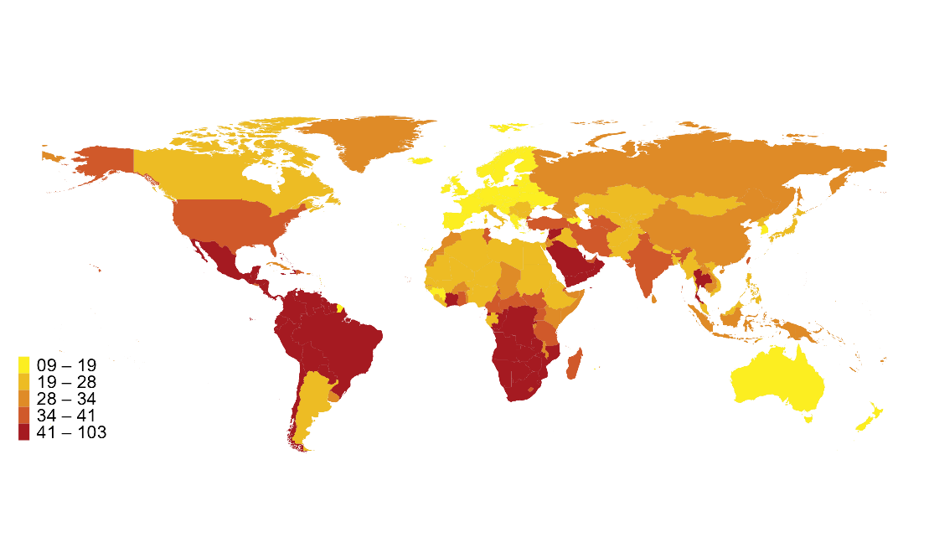
Figure 9. Some countries face the double burden of low incomes and very high inequality
Top 10/bottom 50 income gaps across the world, 2025
Top 10/bottom 50 income gaps across the world, 2025
Interpretation. This map shows the ratio between the income share of the top 10% and the bottom 50% of the population in each country in 2025. Income is measured after pension and unemployment benefits are received by individuals, but before other taxes they pay and transfers they receive. Sources and series: Chancel and Piketty (2021) and wir2026.wid.world/methodology.

Slide 13
Figure 10. Inequality can be reduced with progressive taxation and transfers

Slide 14
Figure 11. Large inequality of opportunity across regions

Slide 15
Figure 12. The ultra-rich escape progressive taxation

Slide 16
Figure 13. The international financial system generates more inequality

Slide 17
Figure 14. Privileged countries face lower liability costs by political design, not market dynamics

Slide 18
Figure 15. We need political action but political coalitions are difficult to form

Slide 19
Figure 16. Divides between large cities and smaller towns have reached levels unseen in a century

Slide 20
Figure 17. Without redistribution, political inequality will increase

Slide 21
Figure 18. Minimum taxation can safeguard progressivity at the top and its revenue can decrease inequality
Global tax justice proposals with baseline, moderate, and ambitious scenarios
 | Baseline | Baseline | Moderate | Moderate | Ambitious | Ambitious
Wealth tax | 2% on net wealth > 100m US$ | 2% on net wealth > 100m US$ | 3% on net wealth > 100m US$ | 3% on net wealth > 100m US$ | 5% on net wealth > 100m US$ | 5% on net wealth > 100m US$
Adults affected | Top 0.002% (92,140) | Top 0.002% (92,140) | Top 0.002% (92,140) | Top 0.002% (92,140) | Top 0.002%(92,140) | Top 0.002%(92,140)
Tax revenue ($ billion) | 503 | 503 | 754 | 754 | 1,256 | 1,256
Annual tax revenue as a % of global GDP (2025) | 0.45% | 0.45% | 0.67% | 0.67% | 1.11% | 1.11%
Annual tax revenue as a % of total education expenditure in Sub-Saharan Africa and South & Southeast Asia (2025) | 1.2x | 1.2x | 1.7x | 1.7x | 2.9x | 2.9x
Interpretation. This table presents baseline, moderate, and ambitious global wealth tax scenarios applied to centi-millionaires and billionaires worldwide (~92,140 adults). Scenarios vary in rates and thresholds, with projected revenues ranging from 0.45% to 1.11% of global GDP in 2025. Notes. Estimates assume 10% tax evasion. Sources and series: Global Wealth Tax Simulator (wid.world/world-wealth-tax-simulator) and wir2026.wid.world/methodology.

